Slide 1
Software Design and Architecture
Microservices Architecture Style

Slide 2
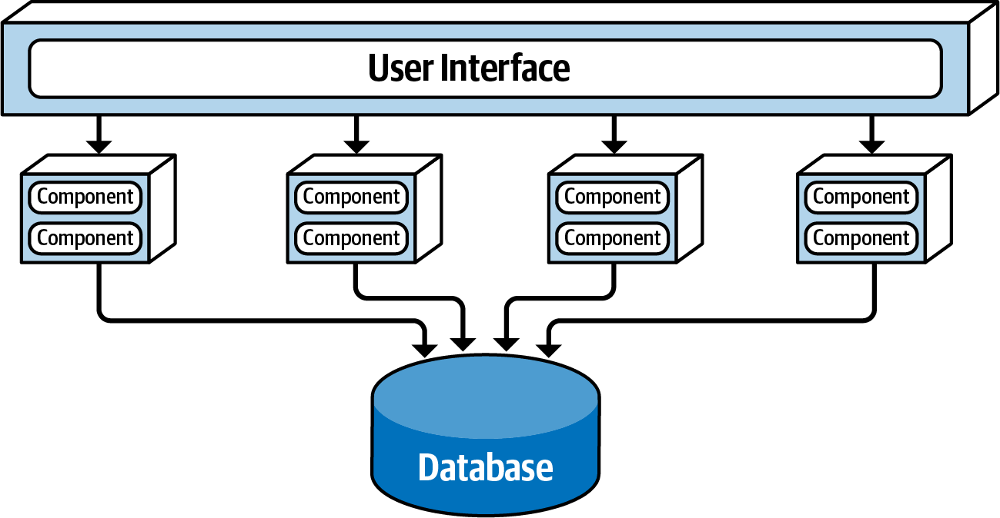
Service-Based Architecture Style
Coarse-grained domain services, deployed as separate units

Slide 3
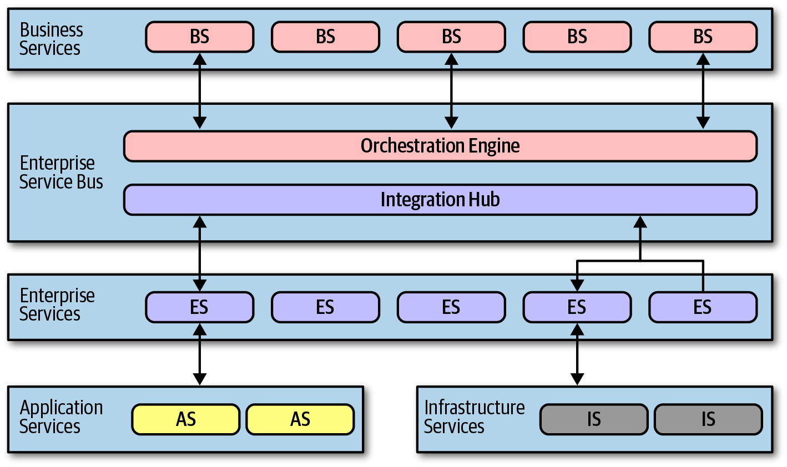
Service-Oriented Architecture Style
Fine-grained enterprise services shared across multiple enterprise heterogeneous systems

Slide 4
Microservices Architecture Style (Share Nothing Architecture)
Inspired by the idea of domain-driven design (DDD)
Take domain partitioning to the extreme
Build self deployed services with own data (Coupling?)

Slide 5
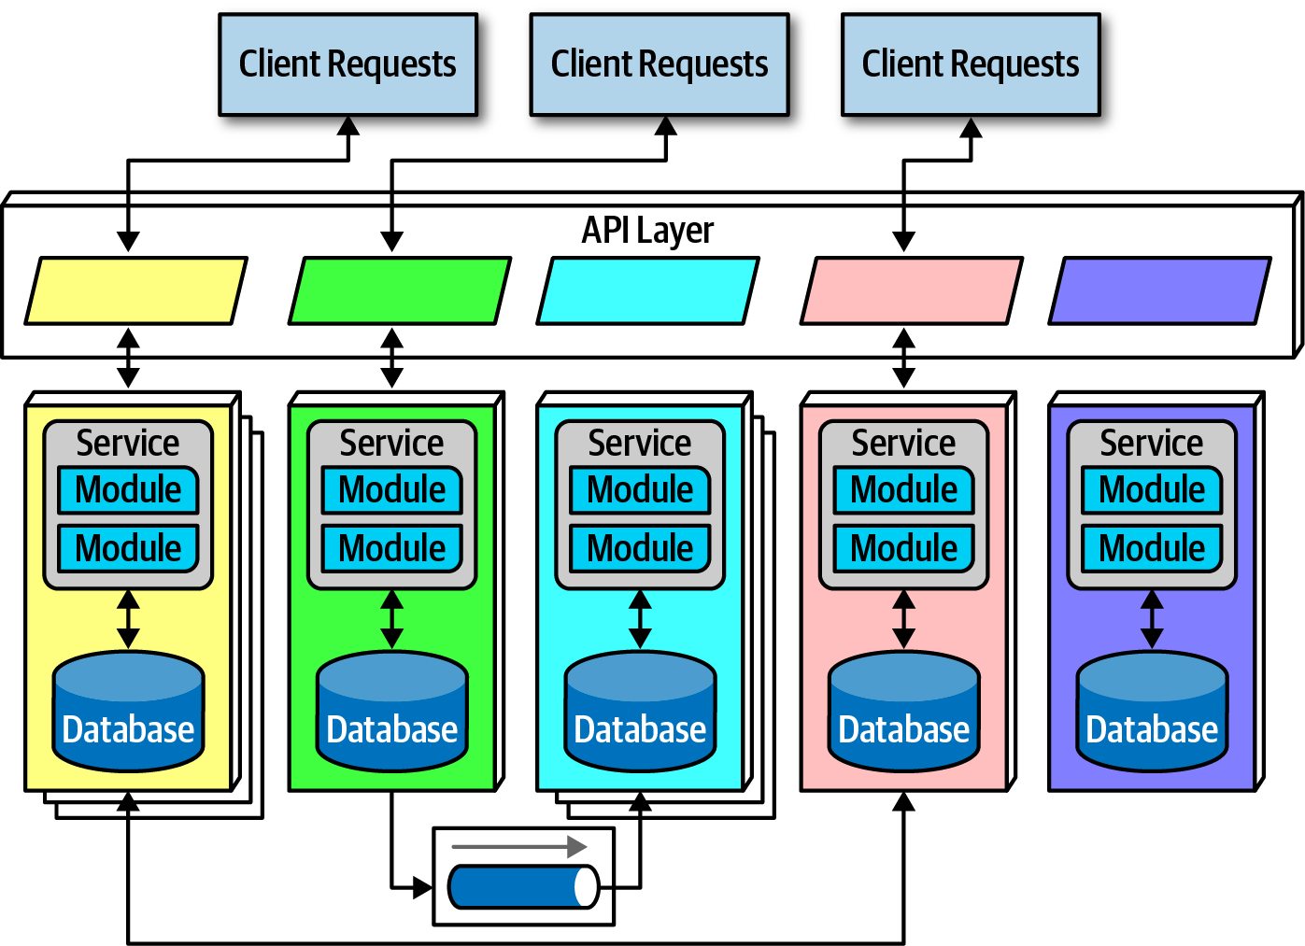
Topology
Prefer Duplication to Coupling
Each service is a single purpose service, separately deployed with its own data

Slide 6
Granularity of Services
Each service, resulted from decoupling, runs in its own process (virtual machines and containers)
Service granularity impacts performance due to a number of network calls and checks such as security verification
Service granularity impacts the use of transactions across service boundaries
Determining “the granularity of services” the key to success in this architecture

Slide 7
Bounded Context
Concept: Bounded Context binds together service functionality along with its corresponding data
Microservices try to avoid coupling, and thus an architect building this architecture style prefers duplication to coupling
Microservices take the concept of a domain-partitioned architecture to the extreme

Slide 8
Bounded Context: Granularity
Guidelines to help find the correct granularity for services in microservices:
Purpose: A domain-partitioned architecture to the extreme
Transactions: A good service boundary is a business workflow often including the entities that need to cooperate in a transaction
Choreography: A set of services that offer excellent domain isolation but require extensive communication to function may be bundled back into a larger service to avoid the communication overhead

Slide 9
Bounded Context: Data Isolation
Microservices favor Duplication to Coupling
NO shared schemas and databases used as integration points for all services
Teams have the advantage in a highly decoupled system to change their mind and choose a more suitable database (or other dependency) without affecting other teams

Slide 10
API Layer
An API layer should not be used as a mediator because all interesting logic in this architecture should occur inside a bounded context

Slide 11
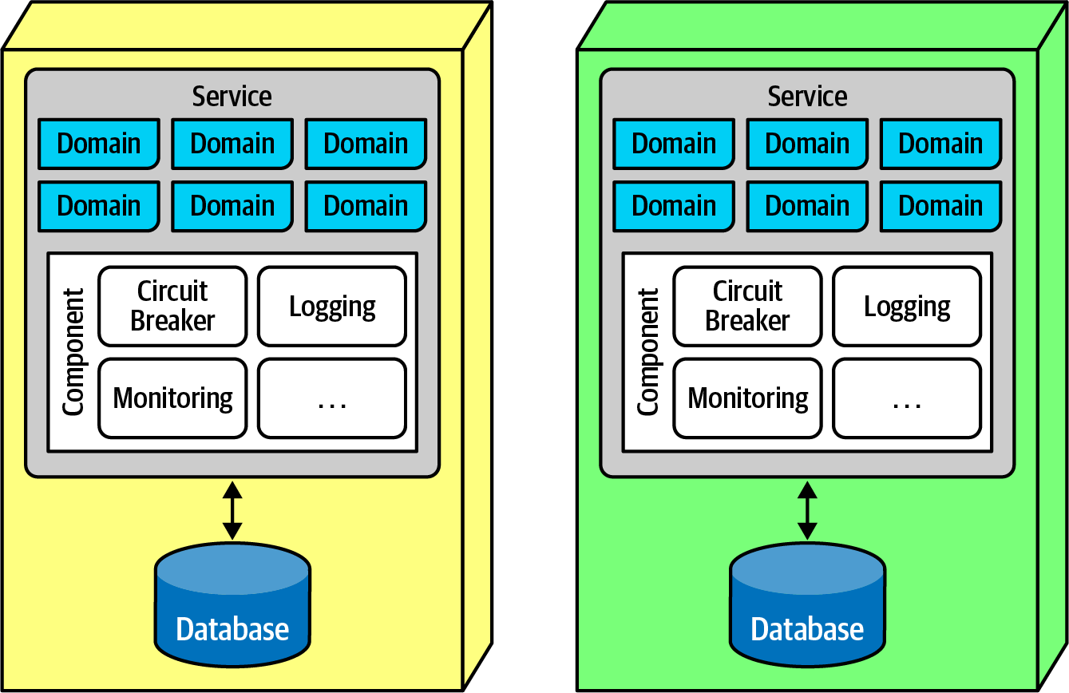
Operational Reuse
Operational concerns like monitoring, logging, and circuit breakers are common elements of all services:
The sidecar pattern is a deployment pattern where operational concerns can be attached to a service without sharing the resources

Slide 12
Operational Reuse
The common operational concerns (owned by either individual teams or a shared infrastructure team) appear within each service as a separate component
When it comes time to upgrade the monitoring tool, the team can update the sidecar, and each microservices receives that new functionality

Slide 13
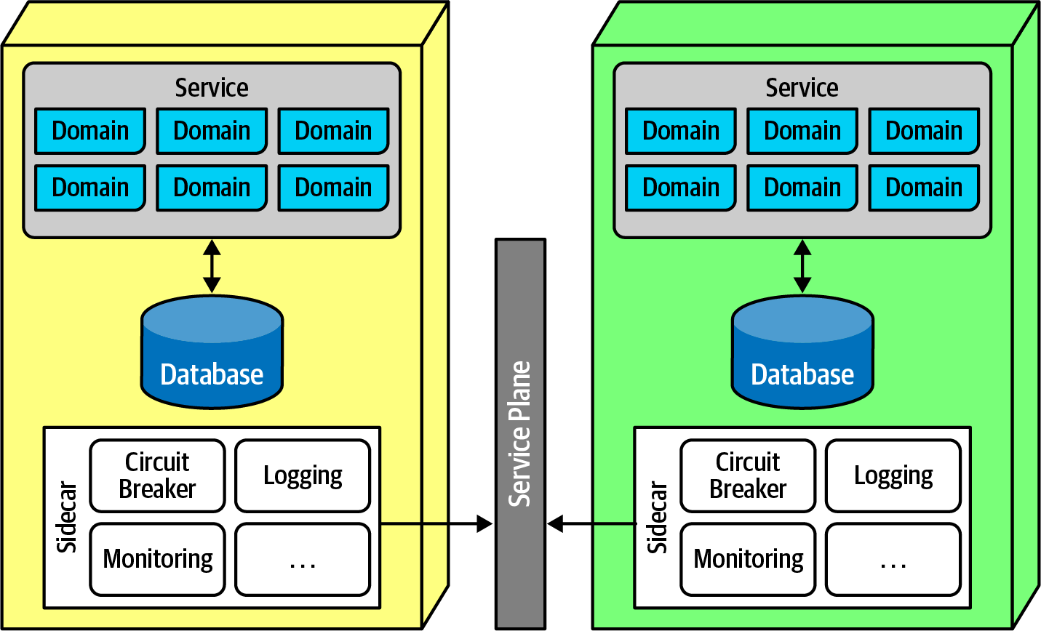
Operational Reuse
The common sidecar components connect to form a consistent operational interface across all microservices to unify control across the architecture

Slide 14
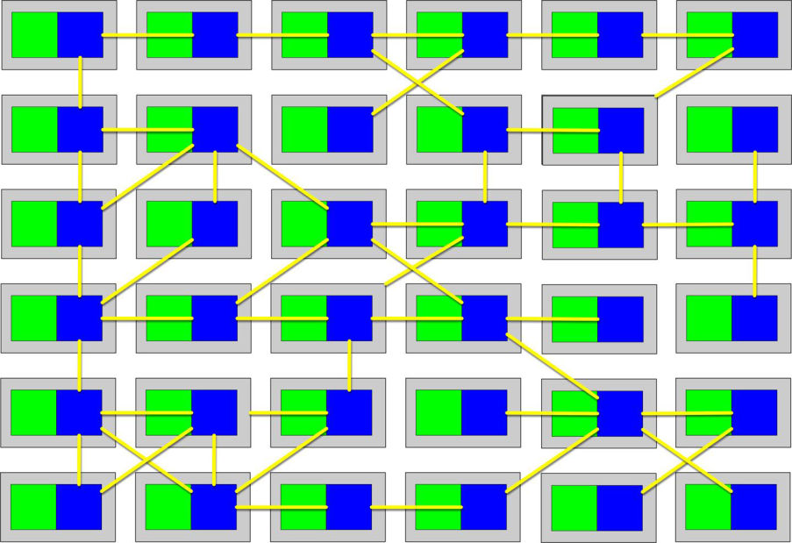
Operational Reuse
The service mesh itself forms a console that allows developers holistic access to services
Each service forms a node in the overall mesh
The service mesh console allows teams to globally control operational coupling, such as monitoring levels, logging, and other cross-cutting operational concerns

Slide 15
Frontends
Microservices favors decoupling:
Each service would ideally encompass the user interfaces as well as backend concerns
So, the original vision for microservices included the user interface as part of the bounded context
In practice:
Monolithic frontend
Microfrontend pattern

Slide 16
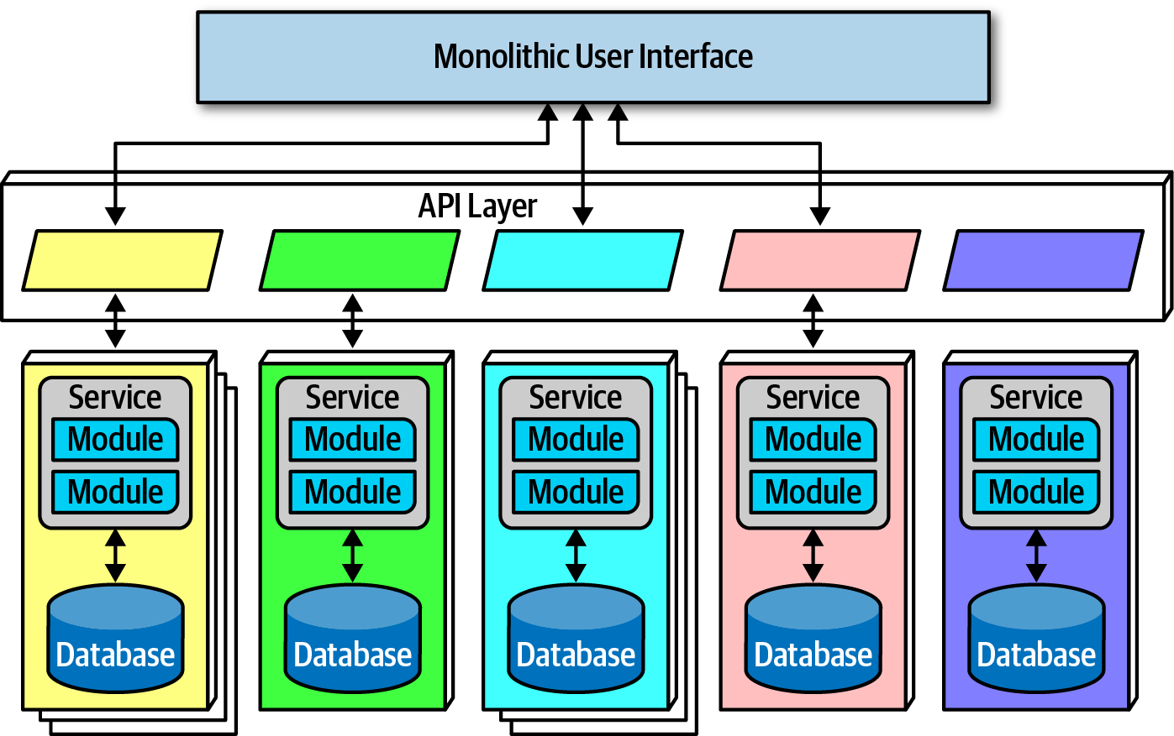
Frontends
Monolithic user interface
The monolithic frontend features a single user interface that calls through the API layer to satisfy user requests
The frontend could be a rich desktop, mobile, or web application

Slide 17
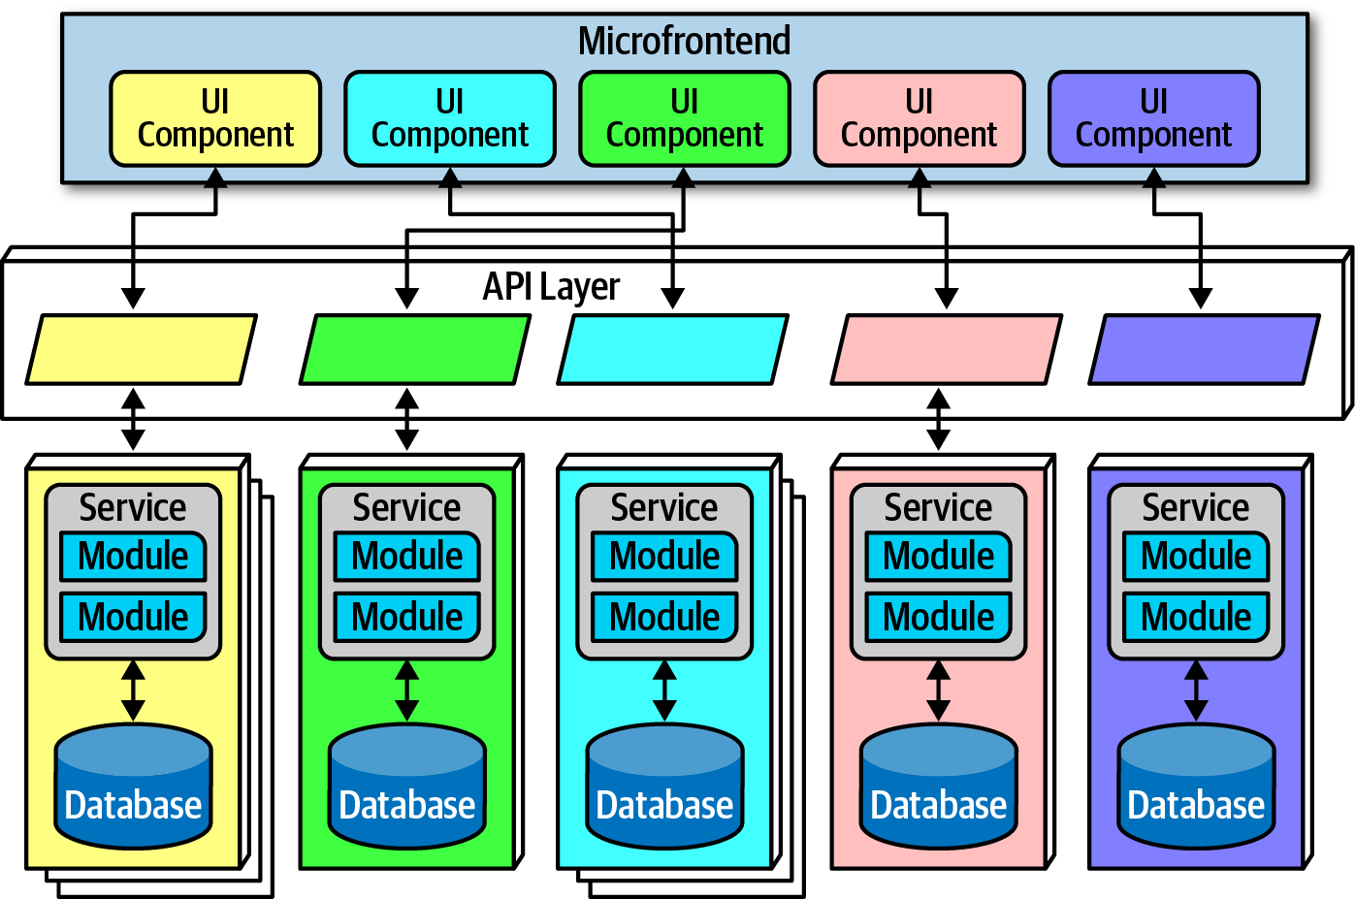
Frontends
Microfrontend pattern:
Utilizes components at the user interface level to create a synchronous level of granularity and isolation as the backend services
Each service emits the user interface for that service, which the frontend coordinates with the other emitted user interface components
Using this pattern, teams can isolate service boundaries from the user interface to the backend services, unifying the entire domain within a single team

Slide 18
Communication
Finding the correct communication style (Sync. Or Async. )helps teams keep services decoupled (granularity of services) yet still coordinated in useful ways

Slide 19
Communication
Microservices architectures typically utilize “protocol-aware heterogeneous interoperability”:
Protocol-aware:
Services must know which protocol to use to call other services
Heterogeneous:
Different services may use different platforms
Interoperability:
Services commonly call other services via the network to collaborate and send/receive information

Slide 20
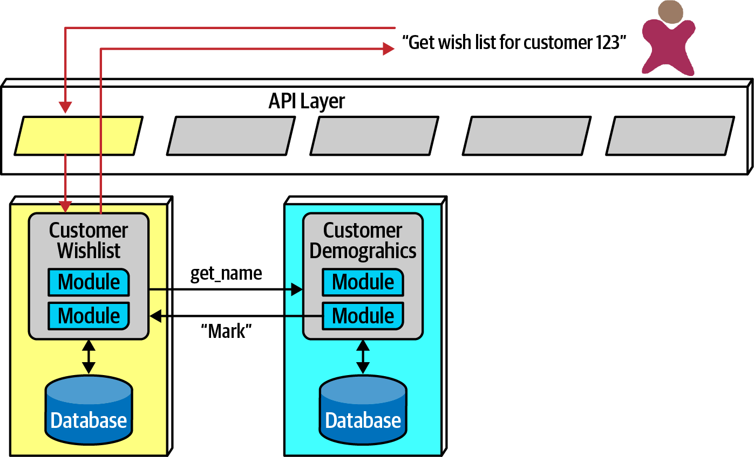
Communication
Choreography (an asynchronous communication style by implementing decoupled events between services)
each service calls other services as needed

Slide 21
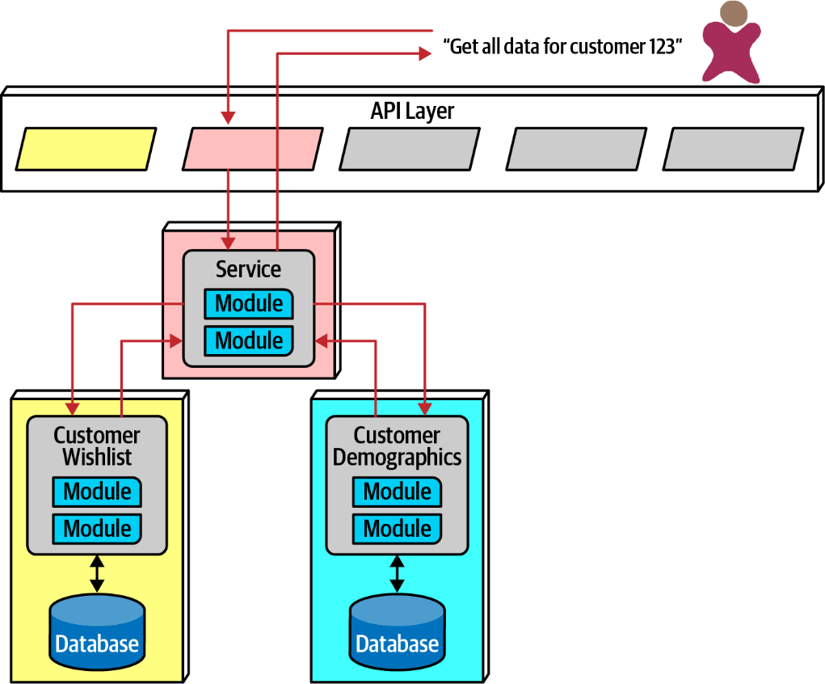
Communication
Orchestration (an asynchronous communication with a mediator)
If an architect needs to coordinate across several services, they can create their own localized mediator

Slide 22
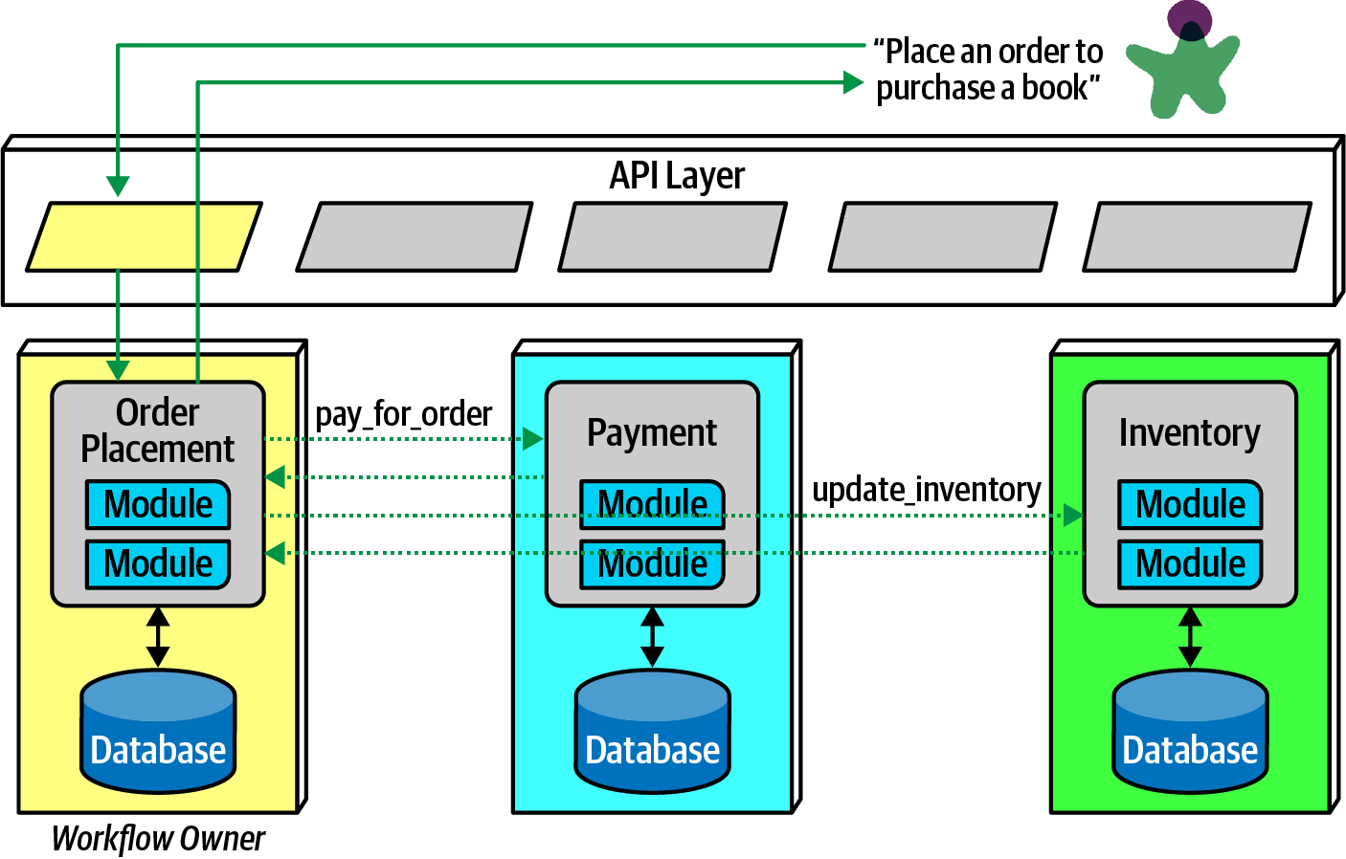
Communication
Using choreography for a complex business process:
The downside to this pattern is added complexity in the service

Slide 23
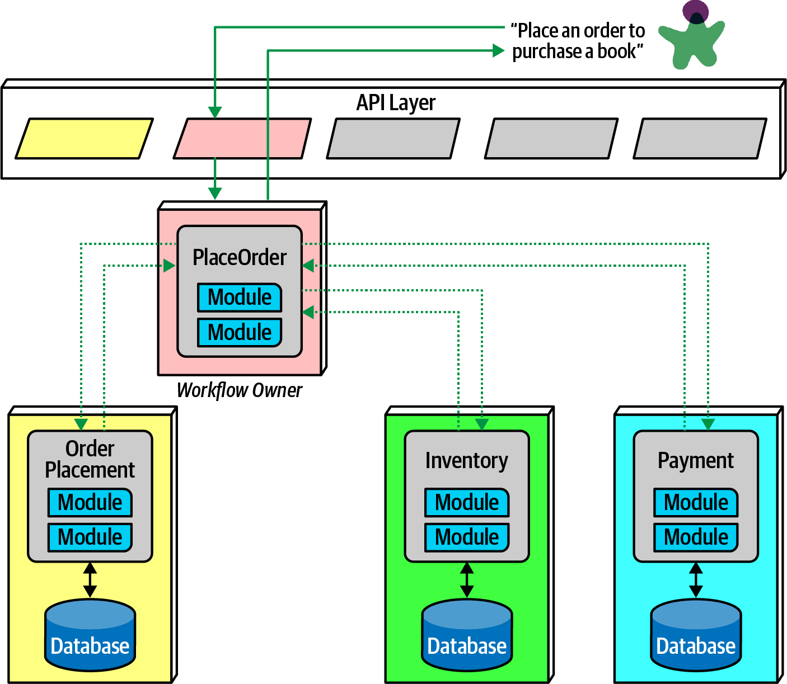
Communication
Using orchestration for a complex business process:

Slide 24
Communication
Transactions
The problem of how to do transactional coordination across services
The best advice for architects who want to do transactions across services is: don’t! Fix the granularity components instead
Transaction boundaries is one of the common indicators of service granularity

Slide 25
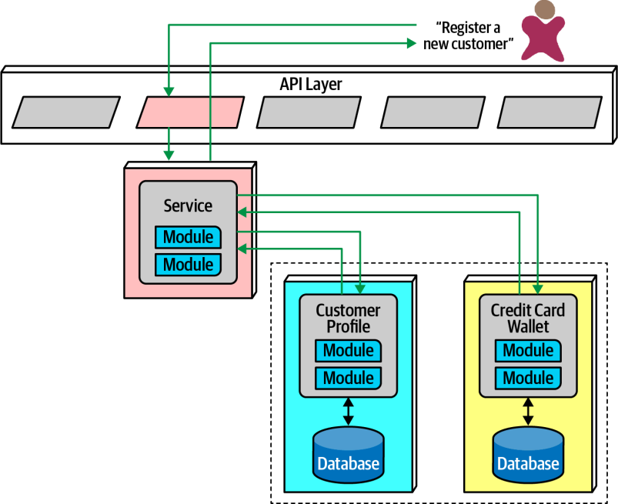
Communication
Sagas
If transactional coordination across services is needed for some reasons
There is a popular distributed transactional pattern in microservices called the saga pattern (a service acts a mediator across multiple service calls and coordinates the transaction)

Slide 26

Communication
Sagas
In an error condition, the mediator must ensure that no part of the transaction succeeds if one part fails

Slide 27
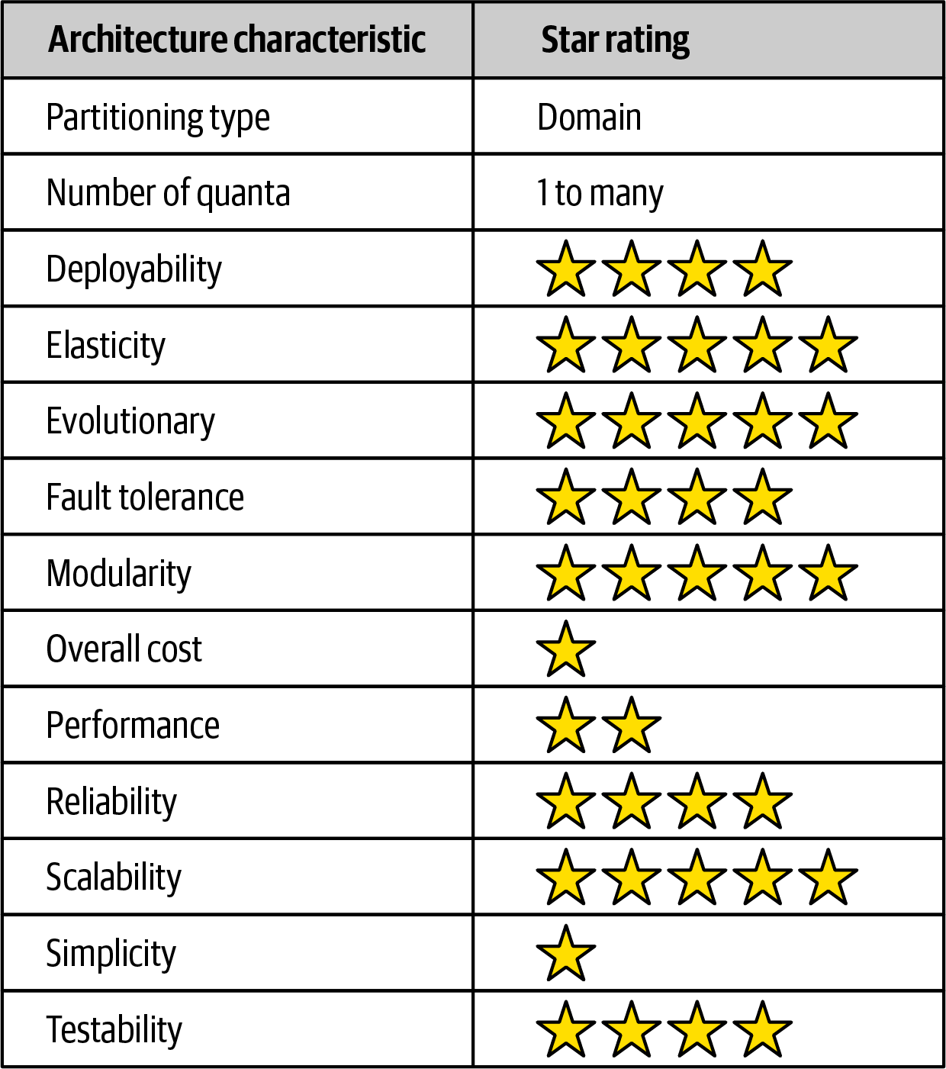
Architecture Characteristics Rating
Deployability, Fault tolerance, Reliability, and Testability: high support
Fault tolerance and Reliability are impacted when too much interservice communication is used

Slide 28
Architecture Characteristics Rating
Elasticity, Evolutionary, Modularity, and Scalability: best support

Slide 29
Architecture Characteristics Rating
Performance: Due to making many network calls and many checks to complete work;
Therefore, many solutions exist to improve performance

Slide 30
Architecture Characteristics Rating
Partitioning type: A domain-centered architecture, where each service boundary should correspond to domains
Number of quanta:
It has the most distinct quanta of any modern architecture

Slide 31
Additional References
Building Microservices by Sam Newman (O’Reilly)
Microservices vs. Service-Oriented Architecture by Mark Richards (O’Reilly)
Microservices AntiPatterns and Pitfalls by Mark Richards (O’Reilly)

Slide 32
Reference
Fundamentals of Software Architecture: An Engineering Approach. Mark Richards and Neal Ford (2020): O’REILLY
Chapter 17

